Slide 2
@JoelDuff – @OFLabour #CommunicationsDirector
@OFLabour
@SidRyan_OFL
OFLabour
@JoelDuff
JoeleeDuff
@JoeleeDuff
Notes:
My name is @_____________, from the @_____________, Hashtag _______________.
You see, we no longer have names, we have handles.
On the screen, you can see the various social media accounts I use – please feel free to follow me, or friend me.
Of course, you should also follow the CLC at @CanadianLabour and @CLCOntario
It wouldn’t be a social media presentation if we weren’t all Tweeting and sharing during the presentation, so PLEASE DO. Feel free to post pictures, mention my accounts and be sure to use the hashtag #SOLIDARITWEET! You can also use the hashtag #CANLAB to target the Canadian labour movement. I’ll talk more about hashtags later.
This workshop is harder today than 5 years ago because there is so much more diversity in your experience. Some of you are are new to Facebook and others are talented Tweeters. It is hard to speak to both audiences at once, but that is what we are going to try to do.
This workshop was developed by Joel Duff at the Ontario Federation of Labour and is all about how to use social media tools to advance our activism online. I hope it will also help you figure out how to manage your time!
I will be assuming some basic familiarity with social media, so I won’t be walking your through how to sign up or giving you a step-by-step.
However, I think you’ll find that the material is thorough enough that no one will be left behind, while substantial enough that skilled online activists will walk away with useful tips.
The handouts don’t directly correspond with the presentation. The handouts are there so you can relax and follow the presentation. Take notes at the back, if you like, but rest assured you can always refer to the handout later … or share it with co-workers.
Let’s get a sense of the experience in the room. Can I get a show of hands:
How many of you are NOT on FACEBOOK
How many of you are NOT on TWITTER
Are any of you on INSTAGRAM?
PINTEREST?
GOOGLE PLUS?
Are there others I have left out?
As you can see, the vast majority of you are on Facebook and Twitter. That’s great. This presentation is going to mostly only cover FACEBOOK & TWITTER, because I find those to be the most useful as organizing tools. But I am happy to take questions about others if the time permits.
Because of the subject matter, this session will be more of a presentation than a workshop, but feel free to chime in at any time with questions or to share your own experiences. After all, everyone in this room has expertise of their own.

Slide 3
The Revolution will not be televised … but it may be Tweeted
Notes:
More than at any previous point of history, FEWER companies own MORE traditional newspapers and broadcast media than ever before … and they have an AGENDA! We all know that we can’t rely on the mainstream media to get our stories out.
While we should not ignore or give up on traditional media outlets, after all, they are still hugely popular and help shape public opinion.
BUT social media allows us to reach our members – and the public – on our own!
Essentially, we can BECOME the media! While the same corporate own the internet, the value of these tools themselves is that they are decentralized.
That is a huge advantage to us.

Slide 4
THINGS HAVE CHANGED!
Smartphones now permeate the market.
Compare the Papal proclamation in 2005 versus 2013.
Notes:
Almost more important than the advent of the internet and the development of Social Media, is the incredible pervasiveness of smart phones.
Almost more important than the social media applications themselves is the fact that almost every person in our society now walks around with a telephone/video camera/web browser/emailer and mini computer with them at all times.
If you want to see just how far we have come, look at the difference 8 years can make by comparing these two photos of the papal proclamation in 2005 versus 2013.
The first picture has a sold flip phone recording in the lower right.
[CLICK!]
In the second photo, it looks like a candlelight vigil, with the crowd utterly illuminated with device screens.
As union activists, we need to harness that power.

Slide 5
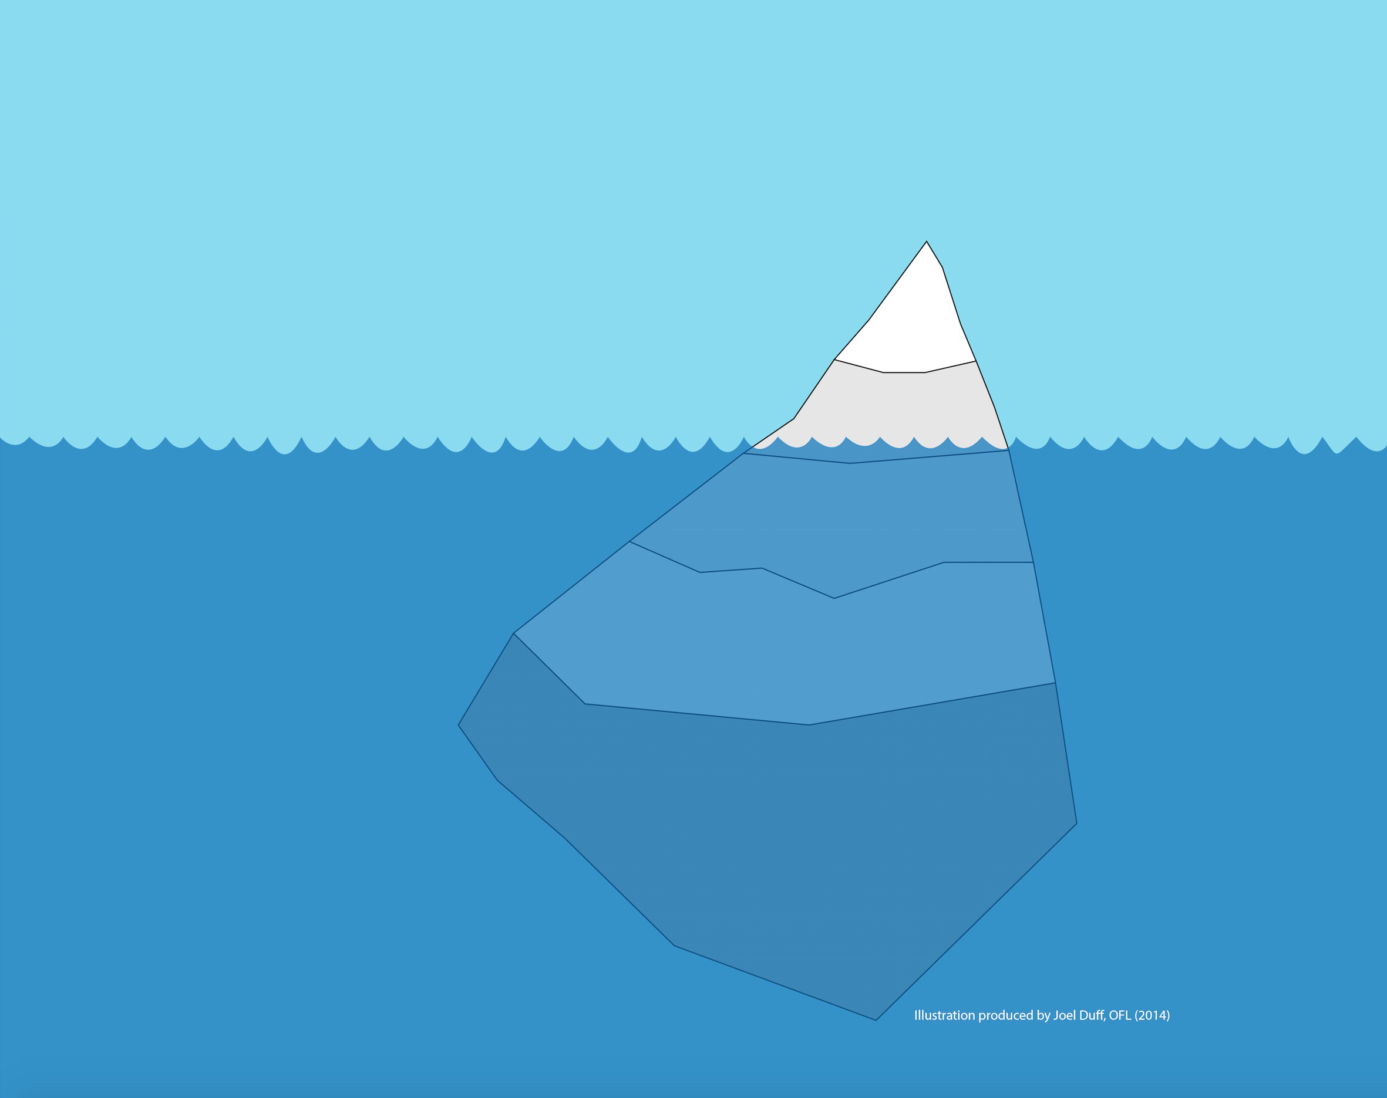
Social Media lets you be the media!
⬅AWARNESS
⬅PERSUASION
SHARING➔
COOPERATION➔
COLLECTIVE➔
ACTION
Notes:
While social media has a similarly small and corporate ownership, the premise of the these applications is that it is the USERS who add the content (and the value).
In many cases, users can also develop applications that expand the platform.
In many cases, reporters can no longer count on their traditional media for break news. Because if they wait for broadcast or publication, people like you will have beaten them to the punch.
… BUT it also does so much more. It allows us to go to where our members are, find new audiences, keep them engaged and amplify social pressure.
In short, social media increases our ORGANIZING potential.

Slide 6
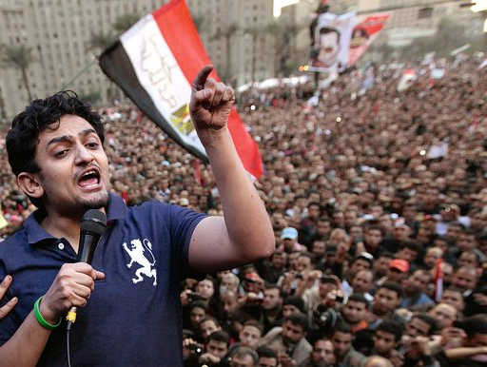
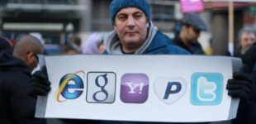
Arab
Spring
2011
Notes:
We all watched the “Arab Spring” in 2011 with awe as we learned of the amazing organizing potential of social media.
Twitter and Facebook allowed for the creation of a new kind of movement. It was leaderless, it was immediate, it was nimble and it was irrepressible.
Rallies were called on Facebook, Twitter was used to out-maneuver the police and all of it happened before the eyes of the international community.
The model quickly spread from Egypt to Libya to Syria and across North Africa. In Canada, helped inspire the Occupy Movement, Québec student protests and Idle No More.
But it is important to learn the lessons it taught us.
Wael Ghonim was an Egyptian activist who started the Facebook page, “We Are All Khaled Said” in honour a protester disappeared by the police.
His page rapidly grew to over 100,000 followers and he was arrested and hidden in a secret jail.
Connected through the internet, an international community instantly rallied to his cause and ultimately secured his release.
[CLICK!]
In Ghonim’s book, “Revolution 2.0”, he says:
“The revolution was on the streets. It was not on Facebook, it was not on Twitter. Those were the tools to relay information, to tell people the truth about what’s happening on the ground.”
Just like any tool, social media platforms can assist, or even enhance, our work, but they cannot replace face-to-face organizing.

Slide 7
Choose the Right Tools
Notes:
Wael’s point is one that you should take to heart. We must be thoughtful and strategic in our campaigns … and we must remember that our movements are made up of people!
You don’t use a hammer for every home repair or a megaphone for every campaign.
There are times for street protests, others for negotiations petitions, radio ads … or plant occupations.
The same goes for social media. A twitter campaign doesn’t serve every issue or reach every audience.
You can waste a lot of time and effort on misplaced tactics.
Social media is incredible way to reach new audiences or keep existing ones engaged. You can tap into new networks to amplify your message.
All of these attributes can give us unprecedented outreach capacity ... But social media is NEVER an alternative for face-to-face organizing.
It is only a supplement to traditional organizing.
There is no substitute for the type of connection that you can made in person.

Slide 8
Choosing Your Tools
FACEBOOK
TWITTER
INSTAGRAM
Social Network
Micro-Blog
Photo Diary
Social, political or commercial
Political or commercial
Mainly social or commercial
Friends only
Open access
Open or closed
Text, photos, videos, groups,
events
Primarily text (photos, videos are optional)
Primarily photos or videos (text is optional)
Notes:
Even when launching an online campaign, it is important to select the appropriate tools.
So let’s compare three of the most popular platforms and understand their function in order to better evaluate their usefulness.
Of course, all three platforms are also used for commercial purposes and celebrities, but that isn’t germane to our discussion here. I am going to make the case that only Facebook and Twitter are useful for political organizing. Instagram, which has now superseded Twitter in the number of users really isn’t a tool suited for political organizing, outside of a Politician like Thomas Mulcair who is building a loyal following.
[CLICK!]
Facebook is in equal measure social and political. It is limited to your friends and you can control who sees what content. It is really meant to be structured the way you would structure real friendships, with different friend circles, family and colleagues or acquaintances. You can share text, photos or videos just as easily. You can create groups or events that are open or invite-only. For these reasons, it is a great organizing tool because you can outreach to your networks and connect them with other networks. (GooglePlus works on the same principle, but doesn’t have nearly the number of users as Facebook, so we aren’t going to devote time to it.)
[CLICK!]
Twitter is primarily a public tool, which makes it suited for politics and ideas, but not really for social stuff. Twitter is intended to operate like a public bulletin board where you post, share and comment on news and ideas. You can close your Twitter account to make it private, but what’s the point?
When you tweet, you enter the public dialogue; you become the media. It is a text driven tool that allows photos and videos, but they only ever supplement the text. For these reasons, it is an ideal tool for reaching people you DON’T know, for connecting with reporters or targeting politicians.
[CLICK!]
Instagram is primarily a photo sharing site. Some professional photographers use it to showcase their work, but most of us use it as a sort of photo diary. But the most interesting stuff is the beautiful stuff.
It is most often used as a public tool for looking at pleasing pictures of the things that interest you: food, products, celebrities, photographers or stylists. It is a lot of fun, but not much of an organizing tool. Frankly, if it is intended for sharing pretty pictures, then photos of union meetings in dour rooms have very little appeal. For that reason, we are NOT going to examine how to use Instagram. (Pinterest is another tool that is primarily useful for marketing, inspiration or research. I use it for researching infographics and design ideas, but have yet to see it used effectively for political organizing.)

Slide 9
ApPROACH IT LIKE AN ORGANIZER
The internet is made up of people, so …
Notes:
The trick to using any social media for political organizing is to approach it like we approach everything else … as an ORGANIZER!
I think you will find that all of the same principles apply.
First, you need to remember that the internet has little to do with technology and everything to do with people. After all, very few of us are coders and all of us are users.
The distance and the anonymity of the internet can change the rules of the game … and they make it a breeding ground for haters.
It is much harder to be sincere, to be empathetic, to be subtle or to secure commitments.
But that is what we have to do. We are trying to win hearts and minds, we are trying to inspire people that change is possible and convince them that their effort can make a difference.
So, we need to be positive, hopeful, inviting, accessible and engaging.

Slide 10
When I post to social media, am I putting myself at risk?
If you would say it into a megaphone,
you can say it online
… but be sensible
Notes:
Are you putting yourself at risk by posting to social media? Not if you act sensibly!
The trick to successfully managing social media is the degree to which you conduct yourself online with the same integrity you do in person.
Let’s not be naïve. Don’t say say anything online that you wouldn’t print on the side of a Good Year blimp.
[CLICK!]
Put another way, if you are comfortable saying it into a megaphone, you can probably say it online.
Be smart, think about the public image you want to project and never tweet in anger. PAUSE, give yourself sober second thought and don’t let haters drag you into emotional tirades.
You do those things and you are effectively managing the risk.
And stacked up against those odds, the benefits of social media outreach are far too important to pass up.

Slide 11
What is a Slacktivist?
“The act of participating in obviously pointless activities as an expedient alternative to actually expending effort to fix a problem.”
- The Urban Dictionary
… but you should NEVER use this term.
It is insulting, condescending and demobilizing.
Let’s validate even tiny steps and
encourage people to take another.
Notes:
Can someone define the term “Slacktivist” for me? …
[CLICK!]
The Urban Dictionary – a very reputable source – defines it as: “The act of participating in obviously pointless activities as an expedient alternative to actually expending effort to fix a problem.”
A fairly cynical definition, right!
[CLICK!]
Here is why you should NEVER use this term … because it is insulting, condescending and demobilizing!
I guarantee that NONE OF YOU got started in political action as a fully developed activist.
You all took steps to get to where you are … and I would bet that all of you remember a key person or two who helped you along the way to focus your energies and develop your politics.
So why are we so quick to judge others for not doing ENOUGH?!?
By labeling a previously untapped crop of casual contributors as “Slacktivists” punishes them for not being radical enough even before they have a chance to try.
I say that we should validate even the tiniest of steps and encourage people to take one step further.
We need to create entry points into our movement. Ways for people to feel invited in to political activism.
If you see every click, every like, every share, every follow as an entry point, you will see the potential for social media to help us reach new people, break down the barriers that divide us and invite them into our movements.

Slide 12
The Ladder of Engagement
STEP 1: Reads your content
STEP 2: ‘Likes’ or ‘retweets’ your post
STEP 3: ‘Likes’ or ‘follows’ your Page
STEP 4: Visits your website
STEP 5: Shares your content
STEP 6: Adds their own comments
STEP 7: Makes contact with you
STEP 8: Joins an action or event, etc.
STEP 9: Actively recruits others
STEP 10: Becomes an organizer
Notes:
Here is how it works:
Being an organizer is about building a relationship with people so you can walk them up the ladder of engagement … from wherever they are to where you need them to be.
STEP 1: Reads your content on friend’s feed.
STEP 2: ‘Likes’ or ‘retweets’ your post.
STEP 3: ‘Likes’ or ‘follows’ your Fan Page.
STEP 4: Visits your website or other resource.
STEP 5: Shares your content with a message of support.
STEP 6: Puts their own spin on your content when sharing with others.
STEP 7: Makes direct contact with you or your group.
STEP 8: Participates in your action or event, etc.
STEP 9: Actively recruits others to do the same.
STEP 10: Becomes an active organizer and takes on a leadership role.
No matter where they find themselves on the ladder of engagement, our job is to get them to take one more step.
That is why our online organizing needs to be active, not passive. Always include an ask so that people are being encouraged to do more.

Slide 13
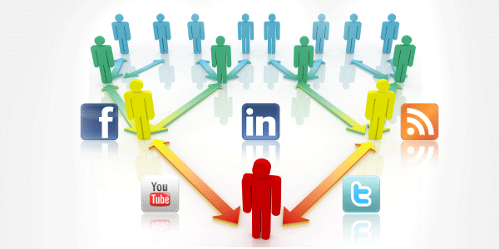
DUH! It’s called “social” media for a reason
Notes:
The key to social media is to use it is an social way.
Technology is just a bunch of tools, but the internet is all about people.

Slide 14
How to Win at Social Media? Embrace the Social!
Social media can make people feel connected & amplifies the message
Develop your personality
Be honest, stay positive
Conversations versus broadcasts

Slide 15
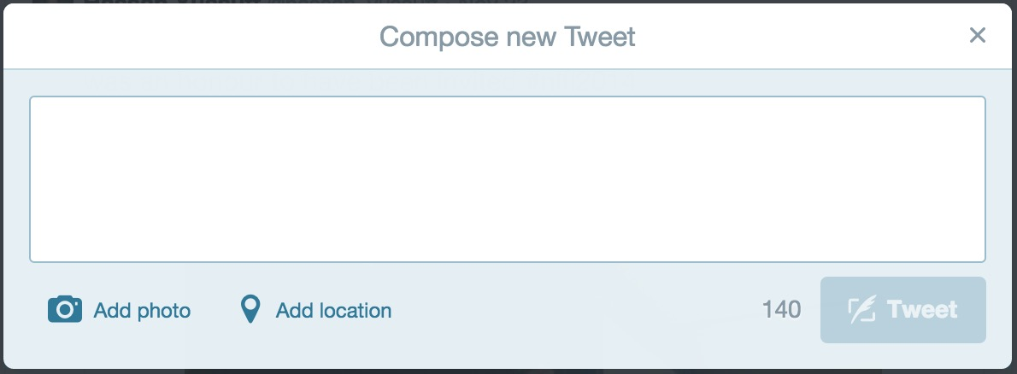
Tip 1: Reciprocity
Reply to posts
Retweet and share
Give a shout-out or props
Thanks for the follow @Tony_Tracy. Glad to fight for
#SocialJustice beside principled ppl like you. #StrongerTogether! #CanLab #Solidarity

Slide 16
Tip 2:
Turn the virtual into the real!
Notes:
I am sure everyone has had the disappointment of organizing an event – whether a protest or a surprise party – and only a fraction of the confirmed Facebook guests showed up.
Well, that’s because simply relying on something passive, like a Facebook “like”, is LAZY organizing.
The best organizers establish a personal commitment from people and translate it into action.
Online organizing is, by definition, distanced. But that simply poses obstacles that must be overcome in developing personal connections.
The more you engage people, the more they feel a momentum behind an initiative, the more they are invested in your cause … they more likely they are to convert their beliefs into action.

Slide 17
Tip 4: Niche Your Knowledge
Post about what you know.
Learn the most common hashtags.
Establish yourself as an expert.
Build a loyal following.
Notes:
How do to get started on Social Media … especially twitter.
Think of it this way. We are all busy people. We don’t have time to be experts on everything. So we build a roster of people we trust – some we know, some we don’t – who we rely on to bring us up to speed. These are people who might post an article about an issue and you can feel confident sharing it because they know their stuff.
On the economy, it could be @TrishHennessy from the CCPA or @JimboStanford from Unifor. On Higher Education, I trust @AngelaRegnier. On international labour issues, my go-to person is @Tony_Tracy from the CLC. I could list a hundred more.
So, start by focusing of a few issues that you are the closest to. It could be workers’ rights, health care, child care, whatever. By posting consistent on those issues, and learn the hashtags other people are using online. The community of people who share your interest and politics will begin to follow you and VOILÀ, you are starting to establishing yourself as an expert!
Broaden it out over time and you will build a loyal base of followers.

Slide 18
Tip 3: Show Your Personality
Show your human side.
Don’t become a political cliché.
Measure your influence by the quality of the engagement, not the number of friends or followers.
Notes:
I used to look down on people who share personal pictures or updates on Facebook. I thought that was for self-indulgent kids, but I was an organizer, so I would only use it for politics. But I have learned that I was wrong.
Facebook and Twitter have been around roughly since 2006. Since that time we have all had the chance to watched people who are solely political and, if you are like me, you have unfriended many of them.
The fact is, they aren’t much fun to be around.
Most people don’t identify themselves through their politics and opinions, so if you do, then you instantly create a barrier between yourself and them. All but the most committed of your friends will ignore your posts and box you out as the “radical friend” or “cousin” or “niece” as the case may be.
However, if they relate to you as a person, they engage with you regularly online – reacting to your family life, your amateur sports analysis or your cooking – then they will also be exposed to your opinions.
Find a balance in the person you project online so that friends and followers can identify with you as a person.

Slide 19
Tip 6: Include an Ask
You have their attention, so use it.
Share this post, Sign a petition, Watch a video, Visit a website, Sign up for campaign updates
Action breeds engagement.
Never squander an opportunity to move someone up one rung on the ladder
Notes:
Just as when you are engaging with people online, every interaction is an opportunity. Don’t squander it.
If you are spending the time to get someone’s attention, once you have it, ask them for more.
This is all about turning passive interactions into active ones.
For example, if you post a video on Facebook or Twitter, don’t say “Watch this video”, which is passive and private, say “SHARE this video” which is active.
It assumes that everyone will watch it, but asks them to take it a step further.
You could ask them to SHARE a post, SIGN a petition, VISIT a website, EMAIL their MP, SIGN UP for campaign updates … anything.
These actions are the best way to MEASURE their commitment … and your impact.
It is also your opportunity to turn SLACKTIVISM into ACTIVISM!

Slide 20
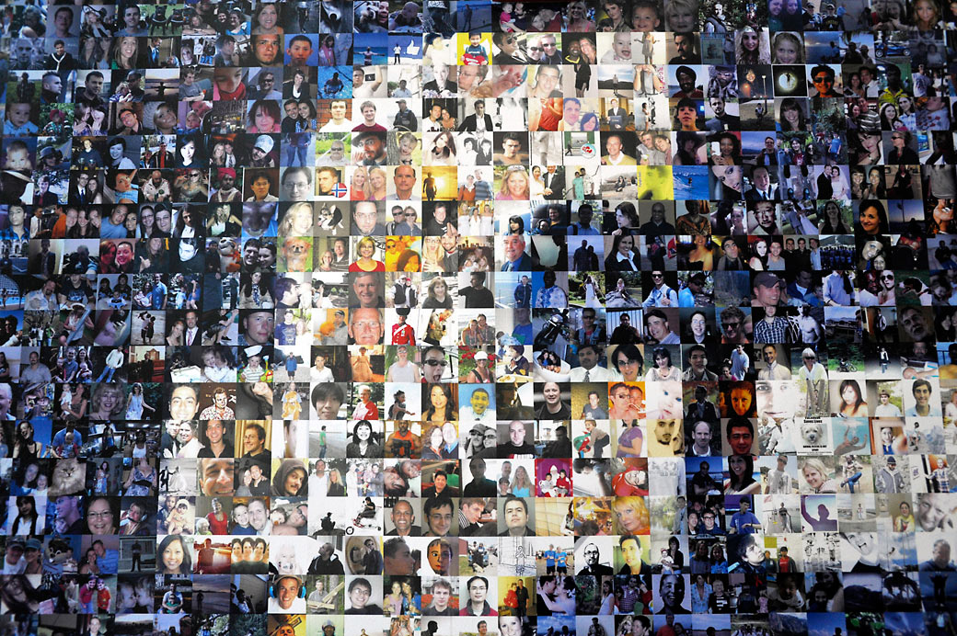
Facebook
Building Labour Community

Slide 21
Knowing Who Your Friends Are
Communities of people already connected
Tap into your networks, & their networks
Privacy settings to limit access
Introducing the new “Graph Search”

Slide 22
Profile vs. Page
Must be a real person.
Usually private.
Friend limit of 5,000.
Allow others to follow you.
Can create events, etc.
For organizations, celebrities.
Access is public.
Anyone can “Like” the page.
Organization can make posts.
Can create events, etc.

Slide 23
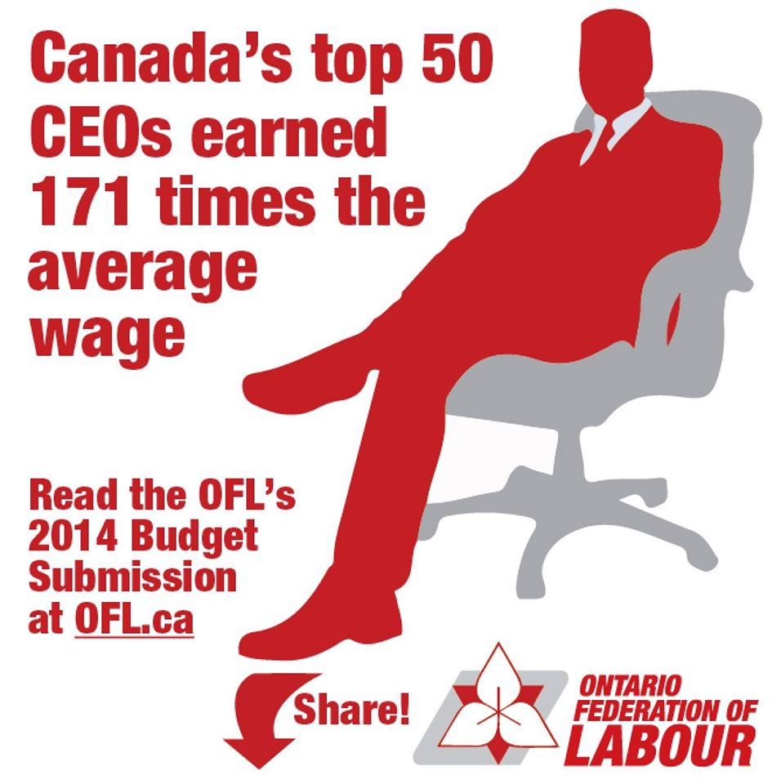
The Perfect Post
Positive, empowering, inspirational, amusing, interesting or exciting encourage sharing.
Photo posts receive 39% higher engagement.
Use simple imagery that can be viewed on a mobile device
Include an “ask” or a call to action
Usually posted mid-afternoon

Slide 24
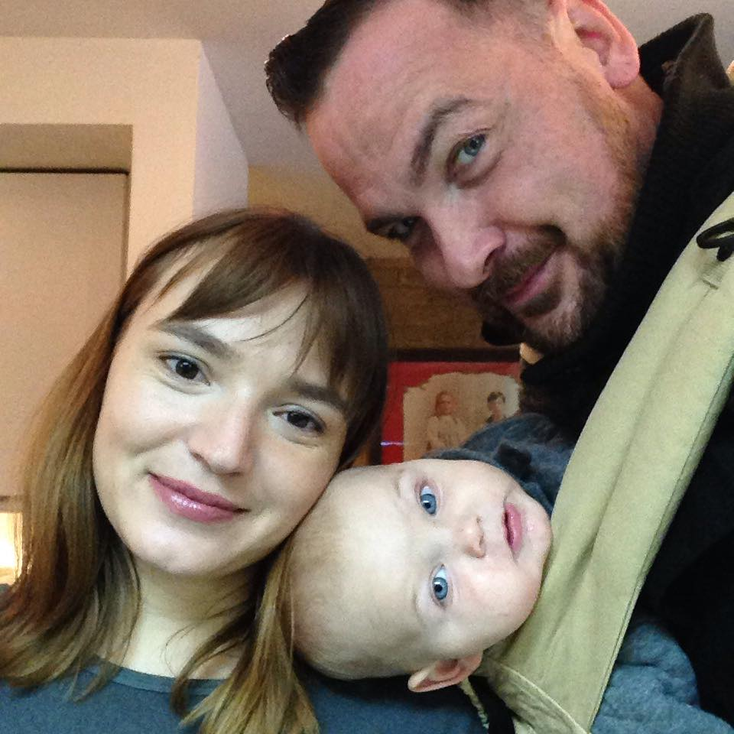
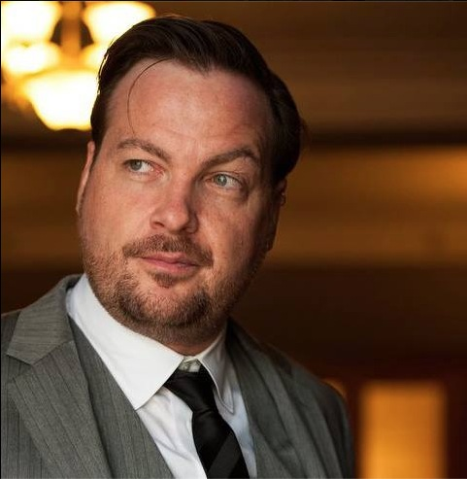
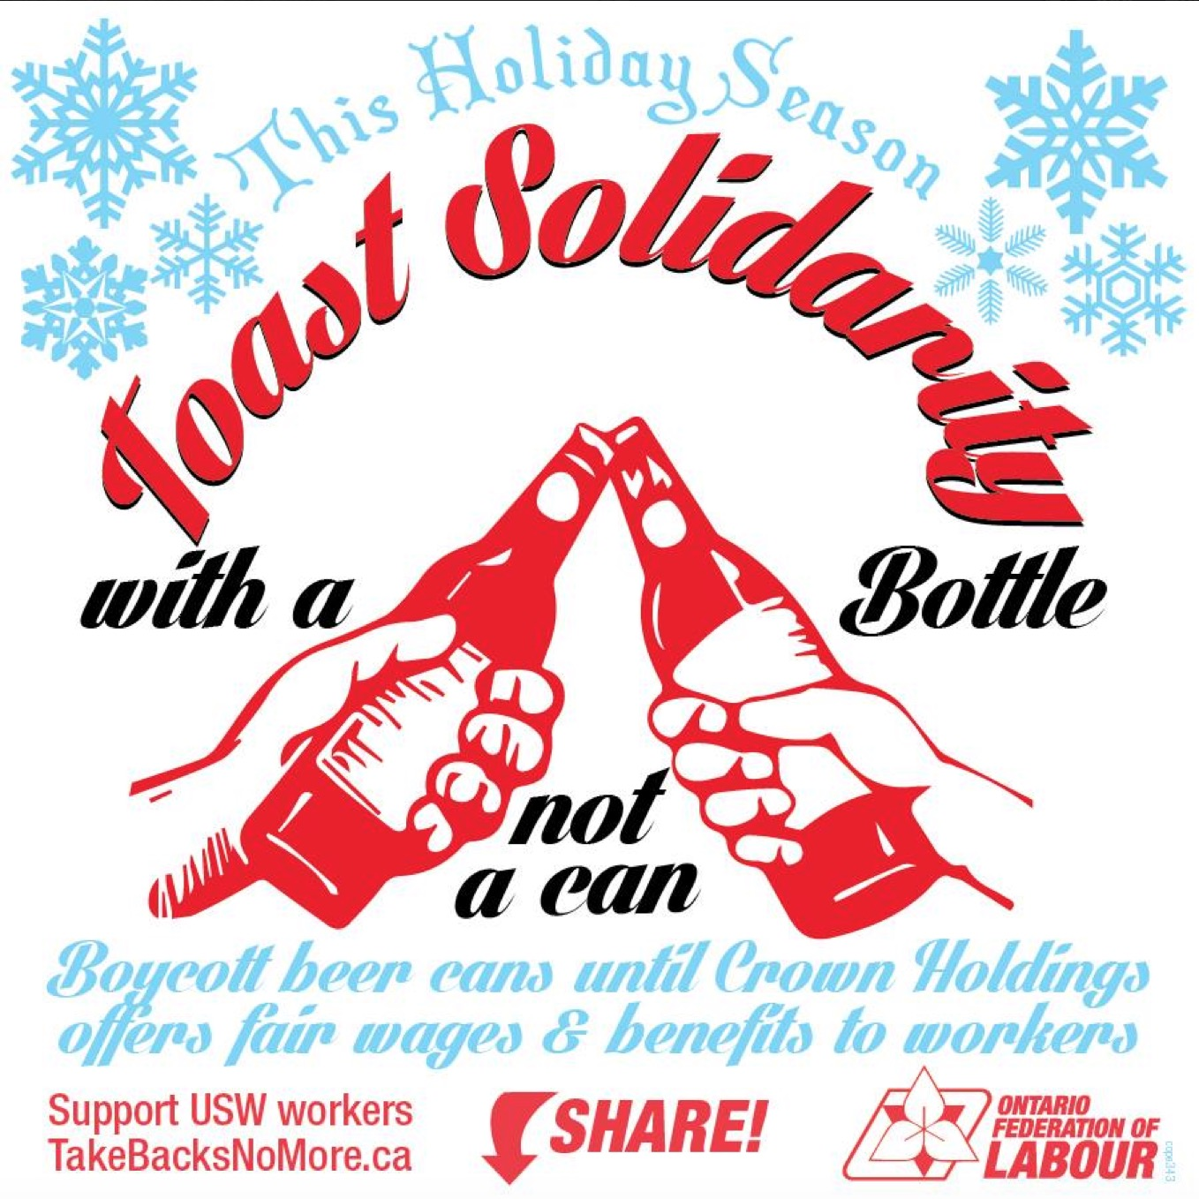
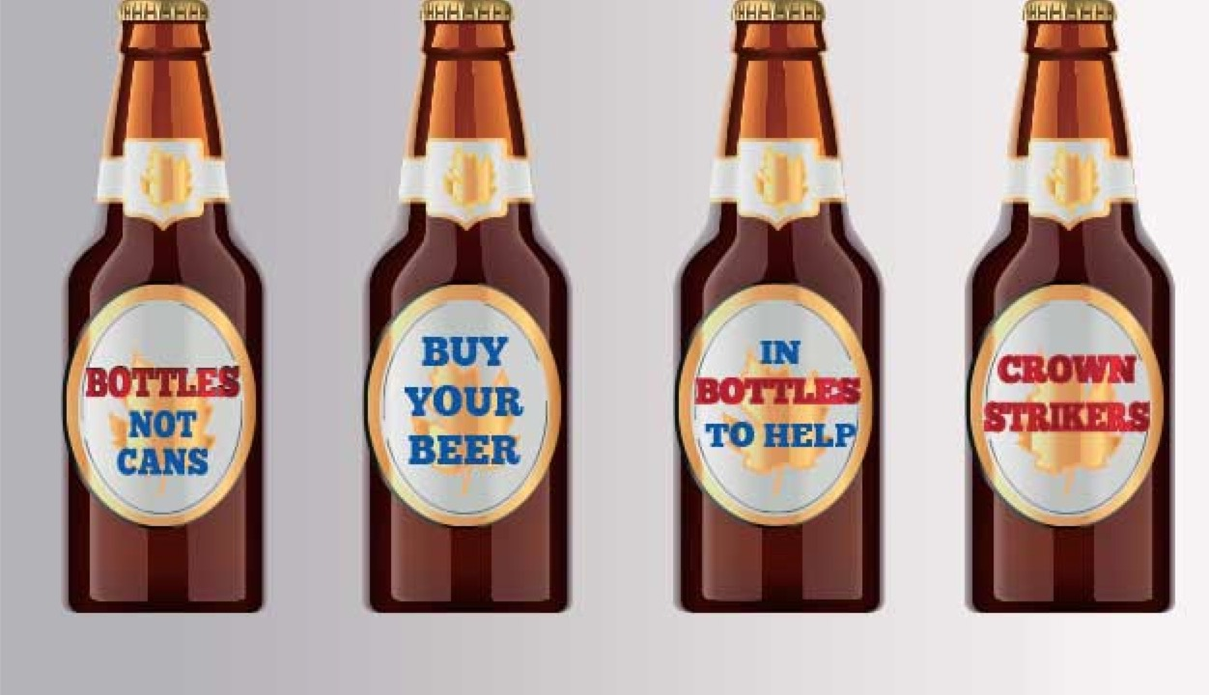
Give Profile to Campaigns

Slide 25
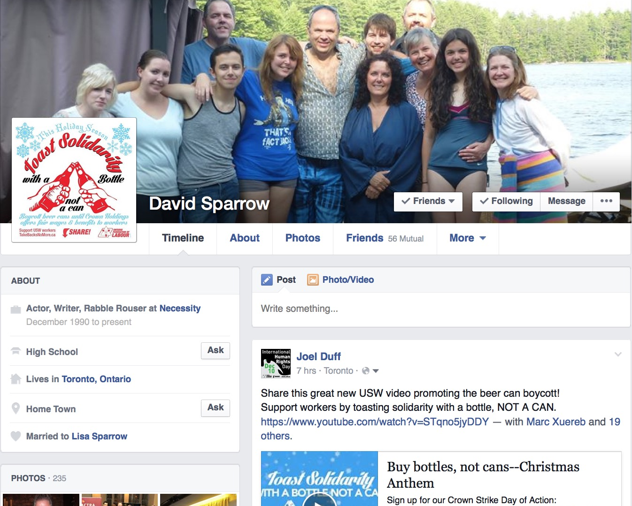
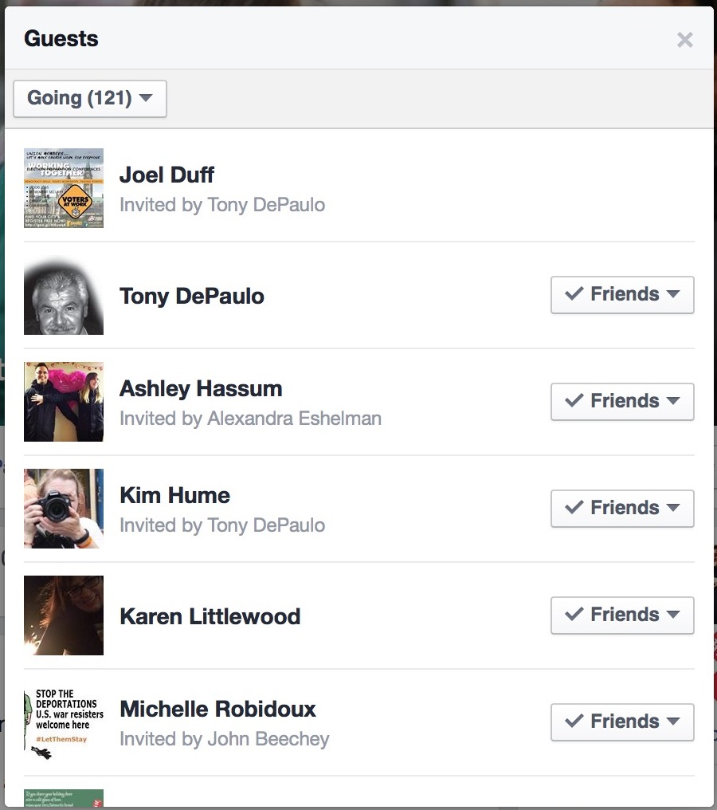
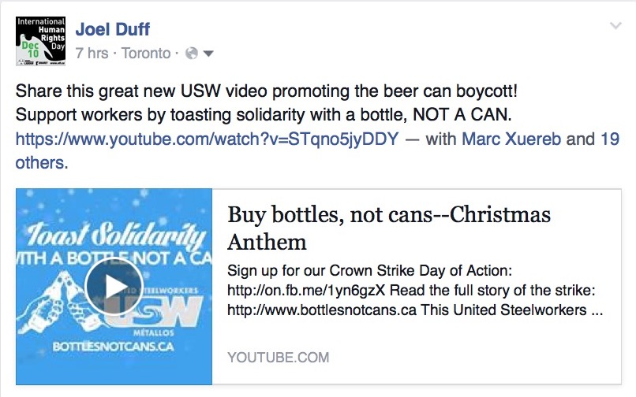

Slide 26
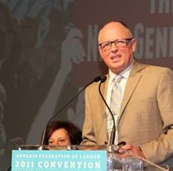
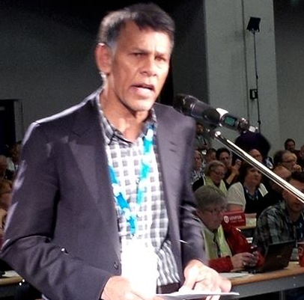
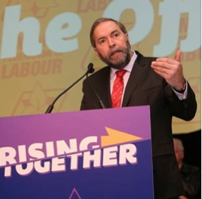
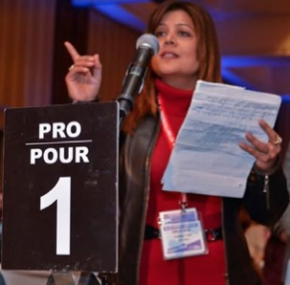
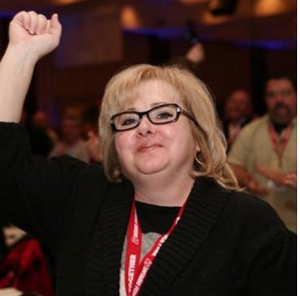
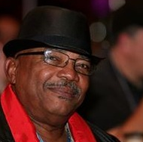
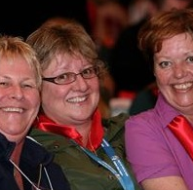
Photos as Social Media

Slide 27
The Meme is the Message
An idea, behaviour or style that spreads from person to person within a culture
Examples: WAZZUP?!? - Where’s the Beef? - Love, Hope and Optimism
Use creative, funny or inspirational images to get others sharing your message

Slide 28
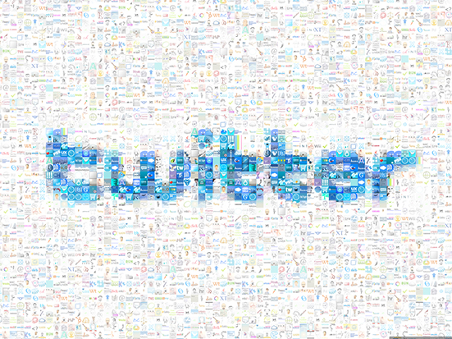
Tweet and They Will Follow

Slide 29
Tweet … and they will follow
Democratizing the media
Building a list of followers from around the world
Everyone can be a commentator
Help make and share the news

Slide 30
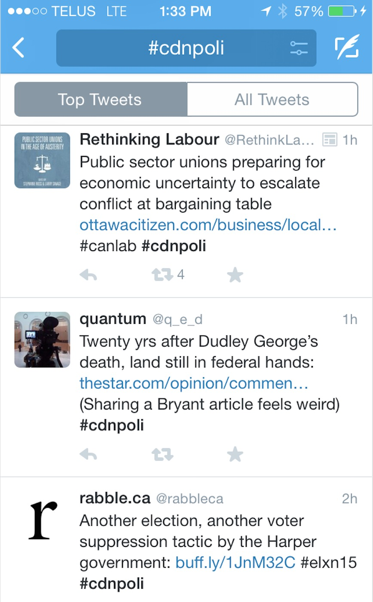
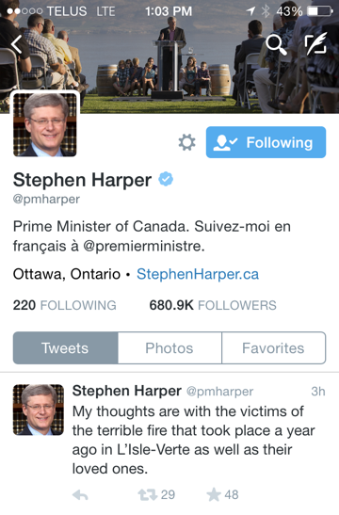
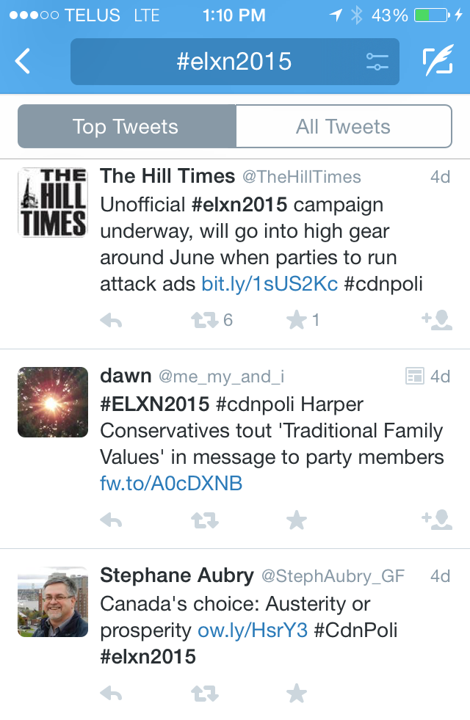
“Tweet”! WTF?
Micro-post or an update in 140 characters
It is like writing in headlines
Childcare, health care, pensions, good jobs:
4 reasons I’m telling neighbours to vote out @PMHarper in #elxn2015. #CdnPoli #CanLab

Slide 31
Being Clever in 140 Characters
Be timely … news window of 2 hours
Old idea + new spin = NEW IDEA!
Leave 20 characters for retweeters
Use the 4 U approach
Only 2-4 hashtags per tweet
R U concerned about #RetirementSecurity, tell @JoeOliver1 to expanded #CPP 4 every worker. #CdnPoli #Pensions
#Too #many #hashtags #is #just #plain #obnoxious.
#EnuffSaid

Slide 32
How to Win at Twitter (1)
Own Your Hashtag
Keep it short!
Add it to email signatures, documents & collateral
Use unique hashtags only for special events

Slide 33
How to Win at Twitter (2)
Humour is the most powerful weapon
“It is always better to be clever than to be an a##hole.”

Slide 34
The. Best. Tweeter. Ever.

Slide 35
How to Win at Twitter (3)
Use @mentions to prompt influencers
Tweet @ journalists, politicians, celebrities
Enlist your partners
.@JustinTrudeau, outing the victims of violence without consent is part of the problem. #BeenRapedNeverReported
Notes:
You may have seen tweets with a [period] before a mention. Like this one that is tweeted at @JustinTrudeau. It isn’t a typo!
Twitter wants to differentiate between public posts and side conversations. If you get into a back-and-forth with @JustinTrudeau, it may not be of interest to everyone, so when you reply to someone on twitter and start you tweet with their handle, you message ONLY appears in their news feed. It isn’t broadcasted publicly. And rightly so!
But there are times when you might want to tweet AT someone like @JustinTrudeau in a very public way, like the tweet shown here.
In this case, by adding a [period] punctuation before the Twitter handle, it outsmarts the Twitter algorithm and appears to all your followers.

Slide 36
Don’t Feed the Trolls

Slide 37
Tips for Time Management

Slide 38
Tip 1: Integrating Profiles
Notes:
Many people ask me about linking their Facebook and Twitter accounts so a post to one appears on the other.
I have tried every variation of this and would argue that it is a BAD idea.
They are very different platforms and you should put thought into what you want to post on each.
If you MUST link your accounts only do it from Twitter to Facebook, not the other way around.
Twitter is generally a public domain, so if you are willing to say it to strangers, it stands to reason that you would say it to your friends.
However, the reverse is not the same. Facebook is generally for friends, so you might share something on Facebook that is not intended for public discussion.
HOWEVER, there are times when you need to post something everywhere instantly. For example, if you are live-tweeting from a media conference, a rally or a bargaining table, you may need to get word out quickly on multiple platforms.
I have a tip to make your life easier.
[CLICK!]
I use a Facebook application called “Selective Tweets”. It is easy to set up and it allows you to connect your Facebook and Twitter accounts.
However, when you post on Twitter, the ONLY tweets that appear on Facebook are the ones you choose.
Once it is set up, all you have to do is add the hashtag “FB” to your tweet and it will automatically appear on your Facebook page.
For example, if you are at at a government media conference and right-to-work legislation is announced, you could use this special hashtag and send the post to Facebook as well.
It is a life saver in those crucial moments where time is of the essence.

Slide 39
Tip 2: Schedule Posts
New to Facebook Pages in 2012
Posts can be timed for future release.
Labour activists are tooling up to defeat the anti-worker agenda in Election 2015. SHARE and SPREAD the word.
Notes:
Facebook added a feature to PAGES in 2012 that lets you schedule a post for a specified time in the future.
This feature is NOT available on your personal profile. There you can only back-date posts.
But on PAGES, you can set a post up to launch when you need it by clicking the drop-down menu beside the “POST” button at the bottom right.
Imagine that you are releasing a report at a media conference next Monday.
You send out your media advisory to draw the press to your event.
At the event, you hand out copies and direct people to your website where they can download the full report.
But you can’t afford to let the report become public before your event starts.
So the night before, you set it up to be posted to your website at a particular time.
And you schedule a post to your Facebook page sharing the link to your website.
While you are at the media conference, the report goes public and is bounced out to social media while you are busy hosting the event.
It is MAGIC!

Slide 40
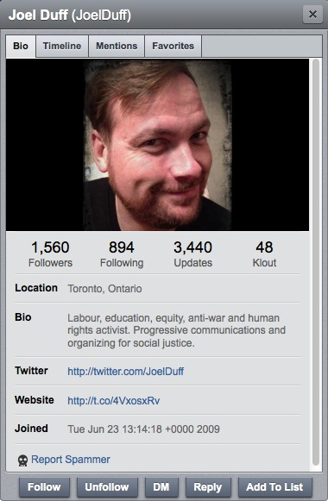
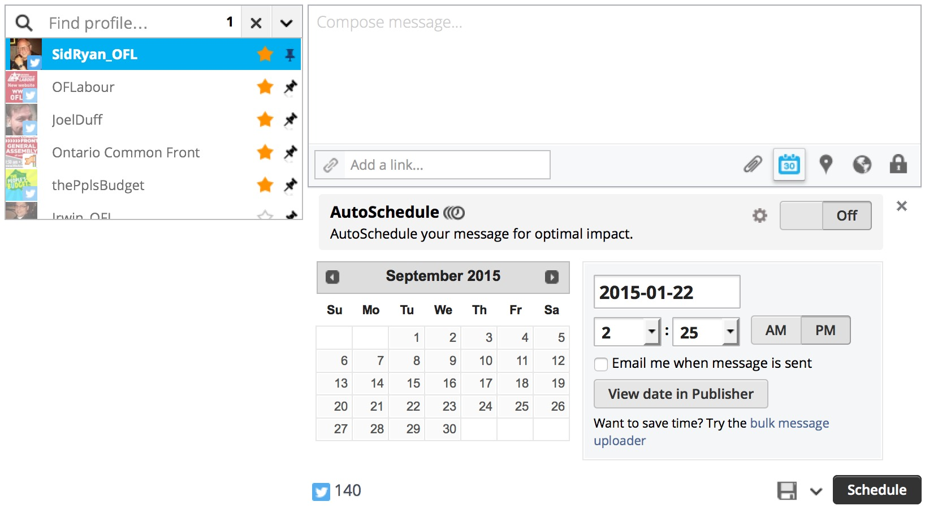
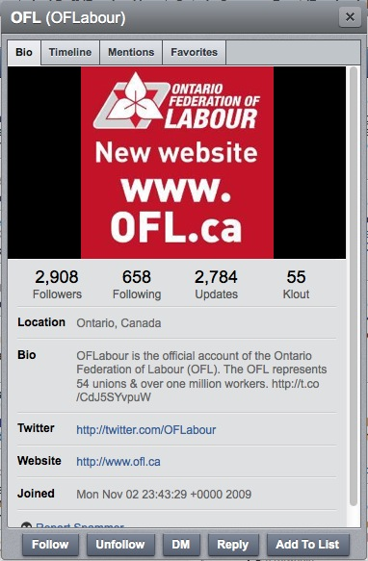
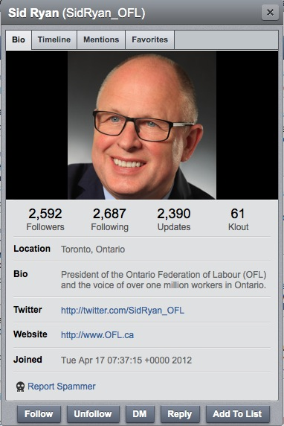
Tip 3: Scheduling Tweets
Game changer! @CanadianLabour & @OFLabour launch member2member campaign 2 defeat #AntiWorker agenda. www.CLC-CTC.ca #Elxn2015
Notes:
There are various Twitter account management platforms – some are free, some have a small monthly fee.
No matter which you choose, they are a great help in managing your posts and they are VITAL to those of us who manage multiple accounts.
I use HootSuite, but TweetDeck is another popular one. They all perform the same essential functions.
Your dashboard allows you to skip between Accounts and schedule posts.
You can write a post, select the sender and decide when it will be posted.
When I am trying to hype an event, I will spend an hour to sit down and write out 3-5 tweets. Then I will set different ones up to be posted by each of my accounts once or twice a day leading up to the event.
Then I spend the rest of the week doing other work to get ready and my tweets keep a-posting … without any additional effort from me.

Slide 41
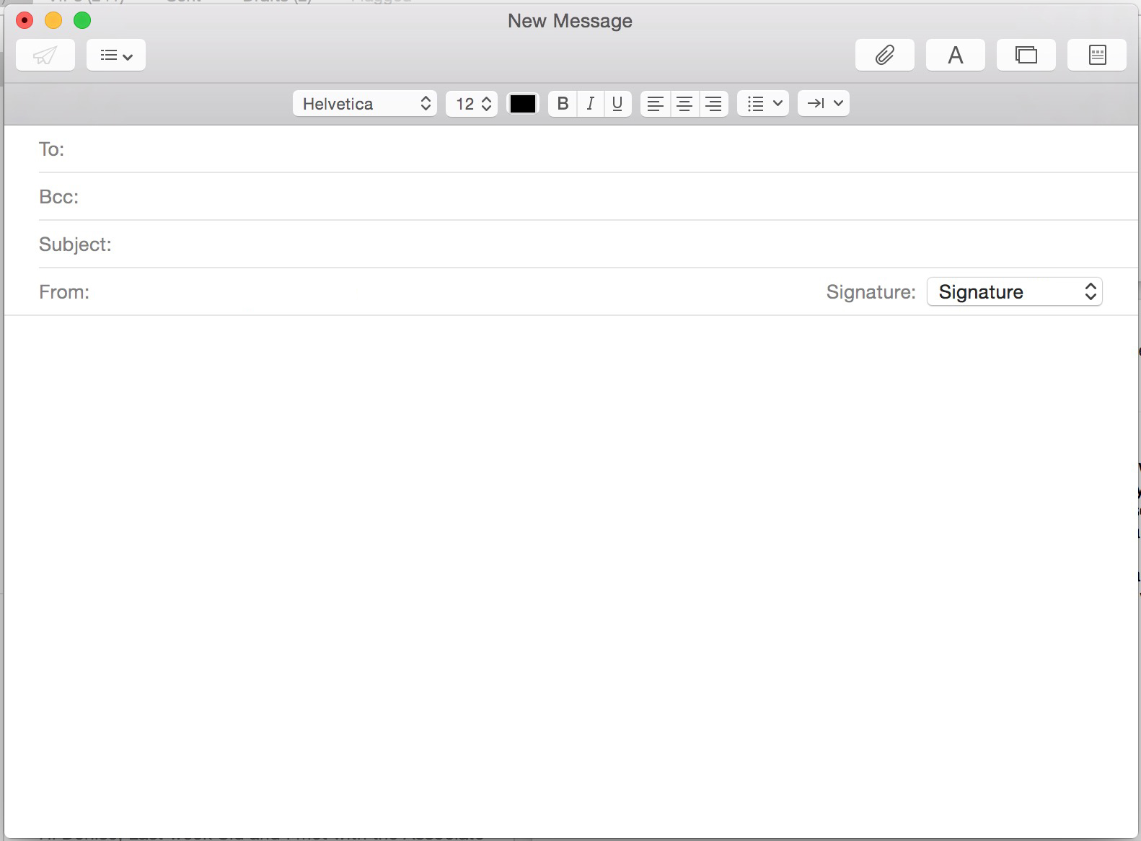
Tip 4: Reach Out Offline for Online Support
Me@MyEmail.com
Undisclosed recipients
Can you help with Twitter support tomorrow?!?
Heya,
Tomorrow, the CLC and OFL are launching our election campaign against Harper. I was hoping your could help to give us an online boost by tweeting and posting on Facebook.
To make it easy, I have included three sample tweets that you can use or modify … or you could write your own:
Since the last time we elected @PMHarper, he’s pushed a a low-wage economy. Not this time. www.CampaignWebsite.ca #CampaignHashtag #elxn2015 #CdnPoli
Canadians deserve better child care, health care & pensions. It’s time to replace @PMHarper. www.CampaignWebsite.ca #CampaignHashtag #elxn2015 #CdnPoli
Notes:
Don’t be passive about your online campaigns and simply hope that they will get traction.
We have all had a friend or colleague ask us to support their event. They send us an email linking to their event with the message “Can you help me get the word out about this.”
You plant your face in your palm!
You are a busy person. Now you have to go to their link, figure out what the event is, think of a tweet, and post it.
That’s a lot of mental energy, and if you are stretched to the limit, you probably don’t do it.
But imagine if you got an email explaining the event, and offering sample tweets that you could easily cut and paste right away. THAT you can handle.
So, don’t just post an event or campaign on social media and hope people promote it, drum up support.
[CLICK!]
I have developed a list of 40-80 of my favourite activists.
When I launch a campaign, I send them all an email in BCC so that it looks like it is just to them (that makes them feel more accountable).
I ask for help with my campaign and provide 2-4 sample tweets, so they can easily cut and paste, but don’t feel like they are being told what to say.
If only 5 or 10 of them actually do it, then my initiative gets an immediate boost.

Slide 42
Feeling Less Overwhelmed?
Notes:
No social media presentation would be complete without a photo of a CAT. My apologies.
Have I missed anything? We have a few minutes to discuss other aspects of social media.
Do you have other questions or o?

Slide 43
www.OFL.ca/index.php/Solidaritweet/
You can view or download this presentation and handouts at:
To sign up for updates from the OFL, text the word “ofl” to:
647-496-5602
Notes:
You can view or download this presentation and handouts at:
www.OFL.ca/index.php/Solidaritweet/
To sign up for updates from the OFL, text the word “ofl” to:
647-496-5602

